Slide 1

SVKM’s Institute of Technology, Dhule Department of Information Technology
Major Project Presentation​
On​
“Real-time Oxygen and Gases Level Detection to Enhanced Safety”​
By
Name of group members
Latika Bhandari (14004210065)
Revati Patil (14004200038)
Aishwarya Patil (14004200029)
Mayuri Tise (14004200056)
Guide
Prof. Bhushan Chaudhari
Day and Date of Review :Saturday, 6 April 2024

Slide 2
Contents
Project Group
Project Motivation
Problem Statement
Project Abstract
Approach to solve the problem / Technology stack
Architecture
Final Model
References

Slide 3
Project Details
Project Title: Real-time Oxygen Level Detection to Enhanced Safety
Project Domain: Internet of Things (IoT) technology
Project Group Members:
1) Latika Bhandari (14004210065)
2) Mayuri Tise (14004200056)
3) Aishwarya Patil (14004200029)
4) Revati Patil (14004200038)

Slide 4
Motivation
The Motivation behind the project is to address crucial challenges in the Environmental sector. The presence of oxygen in the Manhole is essential for the survival of workers and for a number of reasons, measuring and detecting oxygen levels in the manhole is crucial.
Drainage worker Health and Safety: It is crucial to accurately monitor and detect oxygen levels in order to ensure the health and safety of workers.

Slide 5
Problem statement
The project aims to solve the challenges And comprehensive solution for real-time oxygen level detection, aimed at enhancing safety measures in the scenario of manhole. In this upcoming proposed system integrates advanced sensor technology, and user-friendly interfaces to deliver accurate and instantaneous oxygen level measurements with the CO2, Methane, Water level measurements.

Slide 6
Abstract
The Real-time Oxygen Level Detection for Enhanced Safety presents a comprehensive solution for real-time oxygen level detection, aimed at enhancing safety measures in diverse scenarios. In this system integrates advanced sensor technology, data processing, and user-friendly interfaces to deliver accurate and instantaneous oxygen level measurements.
It explores the application of Internet of Things (IoT) technology for real-time oxygen level detection examines how Internet of Things-based oxygen sensors are connected and can process data. The user interface of the system will be designed with efficiency and simplicity in mind. Users can obtain alert logs, and current oxygen level information using intuitive interfaces.

Slide 7
COMPONENT REQUIRED
Node MCU
Breadboard
LCD Display
AO-03 sensor, MQ-6 sensor, MQ-7 sensor, Water sensor
Jumper wire (M-F)

Slide 8
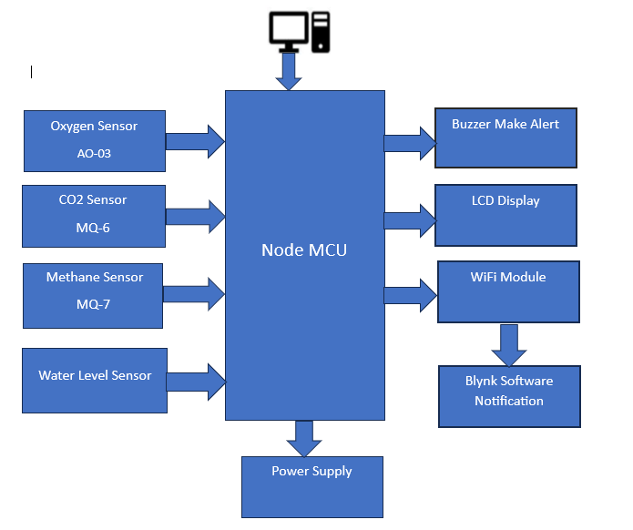
ARCHITECTURE

Slide 9
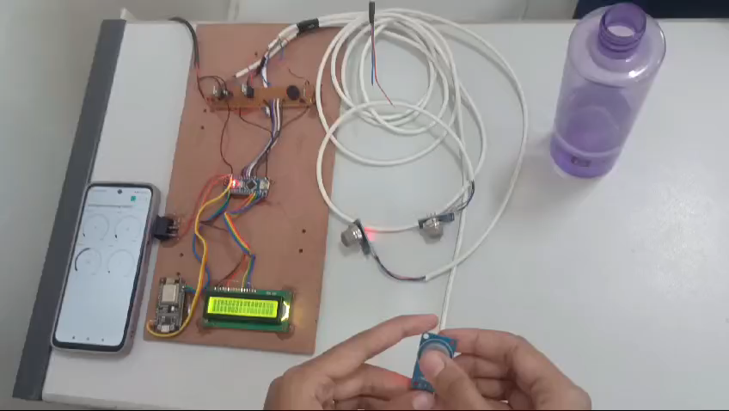
Final Model
Final Model

Slide 10
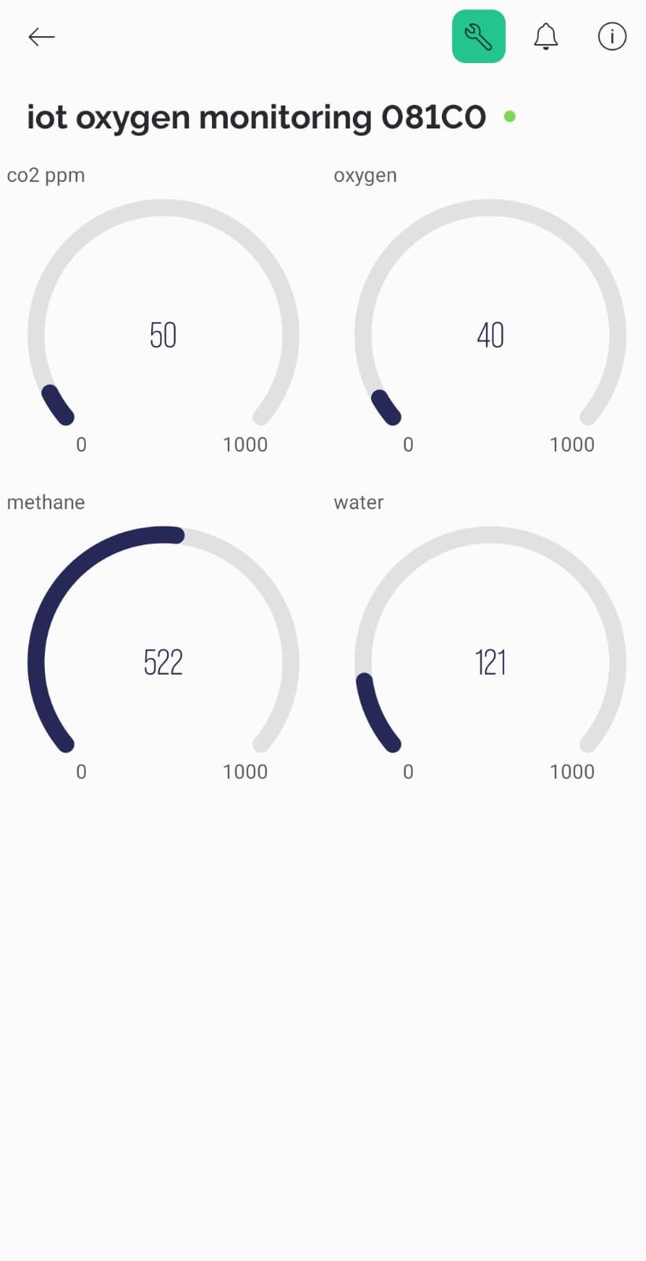
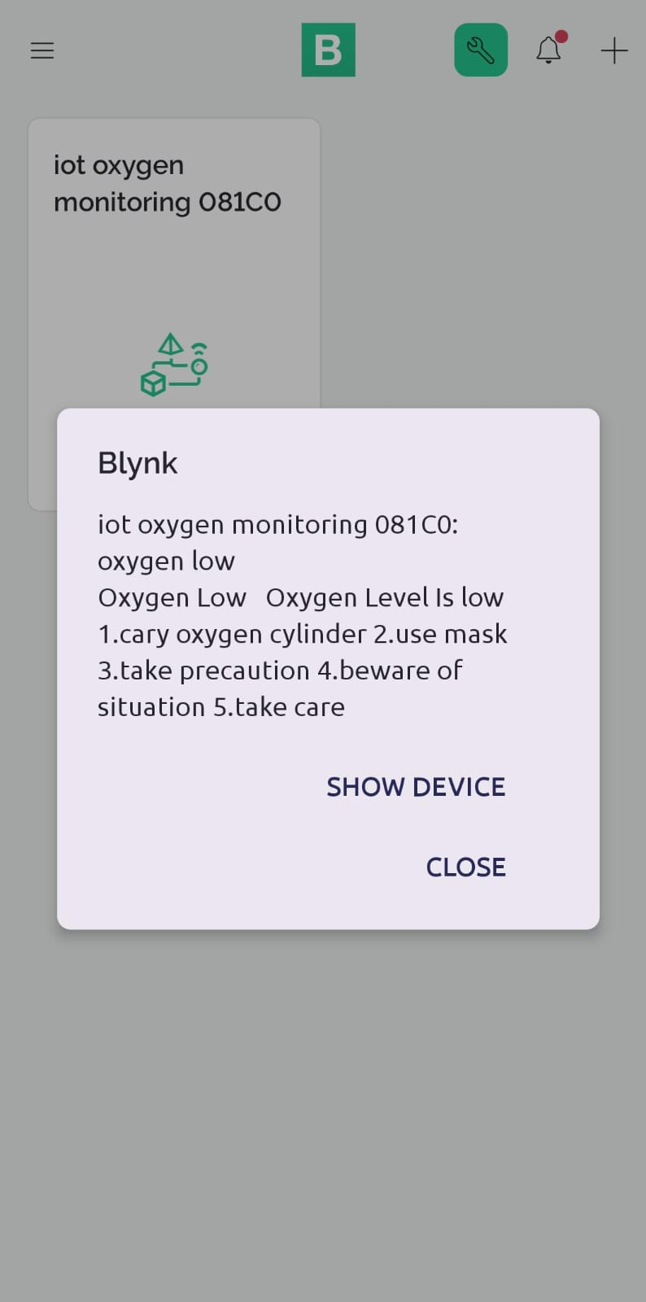
Interface

Slide 11
References
[1] G. Ramesh, D. A. Kumar, P. M. Khan, G. V. K. Teja and B. Singh, "Electronic Sniffing Mask -A Smart Drainage Worker Safety System," 2021 International Conference on Advance Computing and Innovative Technologies in Engineering (ICACITE), Greater Noida, India, 2021, pp. 674-677, doi: 10.1109/ICACITE51222.2021.9404751.
[2] R. Dronavalli, K. Seelam, P. Maganti, J. Gowineni and S. D. Challamalla, "IoT-based Automatic Manhole Observant for Sewage Worker’s Safety," 2022 International Conference on Automation, Computing and Renewable Systems (ICACRS), Pudukkottai, India, 2022, pp. 310-316, doi: 10.1109/ICACRS55517.2022.10029252.
[3] Y. Nandini, K. V. Lakshmi, T. I. S. Srujan, M. Yasheswi and K. S. Jagadish, "Design of Real-Time Automatic Drainage Cleaning and Monitoring System using IoT," 2023 7th International Conference on Computing Methodologies and Communication (ICCMC), Erode, India, 2023, pp. 1291-1296, doi: 10.1109/ICCMC56507.2023.10084257.
[4] S. P. K. Ramadhin, S. Anand, R. Aishwarya and Y. R, "Smart Drainage and Health Monitoring System of Manual Scavenger using IoT," 2021 5th International Conference on Intelligent Computing and Control Systems (ICICCS), Madurai, India, 2021, pp. 412-416, doi: 10.1109/ICICCS51141.2021.9432211.
[5] R. S. Ganesh, M. Mahaboob, J. AN, L. C, P. S and K. K. Kumar, "Smart System for Hazardous Gases Detection and Alert System using Internet of Things," 2021 5th International Conference on Electronics, Communication and Aerospace Technology (ICECA), Coimbatore, India, 2021, pp. 511-515, doi: 10.1109/ICECA52323.2021.9676149.

Slide 12
THANK YOU…!!

